Slide 1
Introducing Your Employee
Assistance Program

Slide 2

Life Comes with Challenges
Your Employee Assistance Program is here to help.
Providing the support you need to:
Improve mental health
Reduce stress
Support whole health
Information | Resources | Referrals
Notes:
Everybody could use a little help sometimes.

Slide 3

All Services Are:
Available 24/7/365
Nationwide
Available to employees, dependents and household members
Pre-paid benefit
Confidential
Notes:
Elaborate on this is also for a spouse, partner, parents, children, and other household members

Slide 4

Services Include:
Mental health and coaching sessions
Financial consultation
Legal referrals
Work-life resources
and referrals
Personal Assistant
Medical Advocacy
Ride Reimbursement
Critical Incident Stress Debriefing
Notes:
We’ll take a closer look at each of these services.
But first …

Slide 5


24-Hour Program Access
Eligibility
Helpline: (888) 993-7650
Member Portal
Employees
Dependents
Household members
Coverage extends for 6 months post-employment

Slide 6

Short Term Counseling
Reach out to your Employee Assistance Program to speak with a mental health clinician about any issue impacting your well-being.
  6 sessions to assist with:
    Manage stress, anxiety, grief, depression
    Cope with change or challenges
    Build self-awareness and practice self-care
    Resolve conflict and improve relationships
    Address substance misuse and recovery
    Talk through any personal issue
Notes:
Explain that this is short-term, solution-focused counseling that includes up to “X” sessions per issue.
They can meet in person, by video, or discuss by phone.
“Life coaching” is different from “counseling.”

Slide 7




Member Experience
Receive care your way with convenient options
for mental health support.
In-the-Moment Counseling Support
Instantly connect to a clinician by phone for urgent clinical matters
Video
Counseling
Schedule a
video session
Telephonic
Sessions
Schedule a
telephonic session
In-Person
Sessions
Meet with a
local clinician from
our network

Slide 8

Life Coaching
Short-term coaching to help you
and your family members:
Achieve personal and professional goals
Manage life transitions
Improve stress and time management
Live a more purposeful life
Overcome obstacles
Strengthen relationships
Improve communication
Manage multiple projects and demands
Notes:
Provide a brief recap on the differences between “coaching” and “counseling”:
Counseling focuses on mental health and emotional healing. People seek counseling for:
Mental health-related symptoms
Problematic emotions and behaviors
Difficult relationship issues
Lingering emotional pain from past experiences
Coaching focuses on setting and achieving goals in all areas of life, such as:
Forming new healthy habits
Making a life decision
Learning a new skill
Tapping into motivation or accountability

Slide 9

Financial Consultation
Connect with a financial counselor for help with:
Coping with financial stress
Building financial awareness
Learning budgeting strategies
Identifying financial goals
Addressing financial challenges
Understanding financial planning

Slide 10

Legal Referrals
Receive legal referrals for personal matters, including:
Eldercare
Estate planning/wills
Real estate
Adoption
Bankruptcy
Divorce
& Family Law

Slide 11

Work-Life Resources and Referrals
Connect with knowledgeable consultants who can help provide referrals and information for family, caregiving and work-life balance needs:
Childcare
Elder care
Pet care
Adoption
Special needs support
Education
Enrichment activities
Housing
Transportation
Community resources and referrals

Slide 12

Personal Assistant
Save time in your day and ask your personal assistant to help with referrals for:
Travel and entertainment
Seeking professional services
Cleaning services
Food delivery
Everyday tasks

Slide 13

Medical Advocacy
Our Medical Advocates are here to help you navigate:
Insurance claims
Obtaining Doctor Referrals
Securing Medical Equipment
Planning for Transitional Care and Discharge

Slide 14

Call a cab, Uber, Lyft, Fasten, or another ride-sharing program
Keep your receipt
Call the helpline for instructions on receiving reimbursement for your ride
Reimbursement up to $45.00- excludes tip
Available once per calendar year per person (age 18+)
May submit receipt up to 60 days from date of service
Take the High Road Ride Reimbursement Program

Slide 15



Critical Incident Stress Debriefings
Dealing with the unexpected...
Critical Incident Support staff are selected from highly qualified clinicians who are experienced in dealing with a variety of critical Incidents. We can provide both group interventions and one-to-one support in a range of scenarios:
Major changes can impact work/family life
Death or injury in the workplace
Industrial accidents and environmental
disasters

Slide 16

Trainings and Webinars
The AllOne Health Employee Assistance Program (EAP) offers a variety of specialized training, orientation sessions, and wellness seminars covering a range of work-life, wellness, and EAP topics. Orientation and educational seminars are one of the most important ways of reaching out to employees, supervisors, and senior-level management.
Training Catalog Topics | Webinar Catalog Topics | On-Demand Webinars | 2025 Supervisor Excellence Webinar Series | 2025 Stress Management Webinar Series | 2025 Leadership Certificate Webinar Series
More than 100 off-the-shelf seminars are available in topics such as People Management, Wellness, Legal/Financial and Personal/Professional Development. | Our 80+ Webinar Catalog seminars are fully customizable and tailored to specific challenges and audiences of the organization. | 70+ on-demand webinars through the AllOne Health member portal may be accessed at any time for individual or group training at home or work. | A series of practical educational programs designed to help supervisors, managers, and other interested employees to build more engaged and productive work teams. | This training series is designed to provide your employees with the knowledge and skills necessary to cope more effectively with stress so they can live healthier and more productive lives. | A quarterly webinar series designed to provide supervisors, managers, and other interested employees with enhanced skills to improve workplace morale, employee motivation, and staff productivity.

Slide 17



Insights Newsletter
We promote mental health awareness and well-being year-round with our Insights monthly newsletter.
Watch your inbox for monthly Insights newsletters
Enjoy monthly articles, videos, and webinar registration links.
Visit the Insights Newsletter Hub at: allonehealth.com/insights
Follow us on social for all the latest resources and news
AllOne Health
Notes:
Discuss how they will receive Insights, our monthly newsletter at the start of each month.
Discuss how the Insights Hub provides easy access to all archived materials.

Slide 18

Member Portal
Visit your member landing page at
allonehealth.com/deeroaks and sign-in to start accessing your benefits:
Connect via live chat, phone, or online requests
Explore the self-service resources
Enhance your well-being with self-care assessments & soft skills courses
Access articles, podcasts, well-being resources and more
Find exclusive marketplace discounts

Slide 19
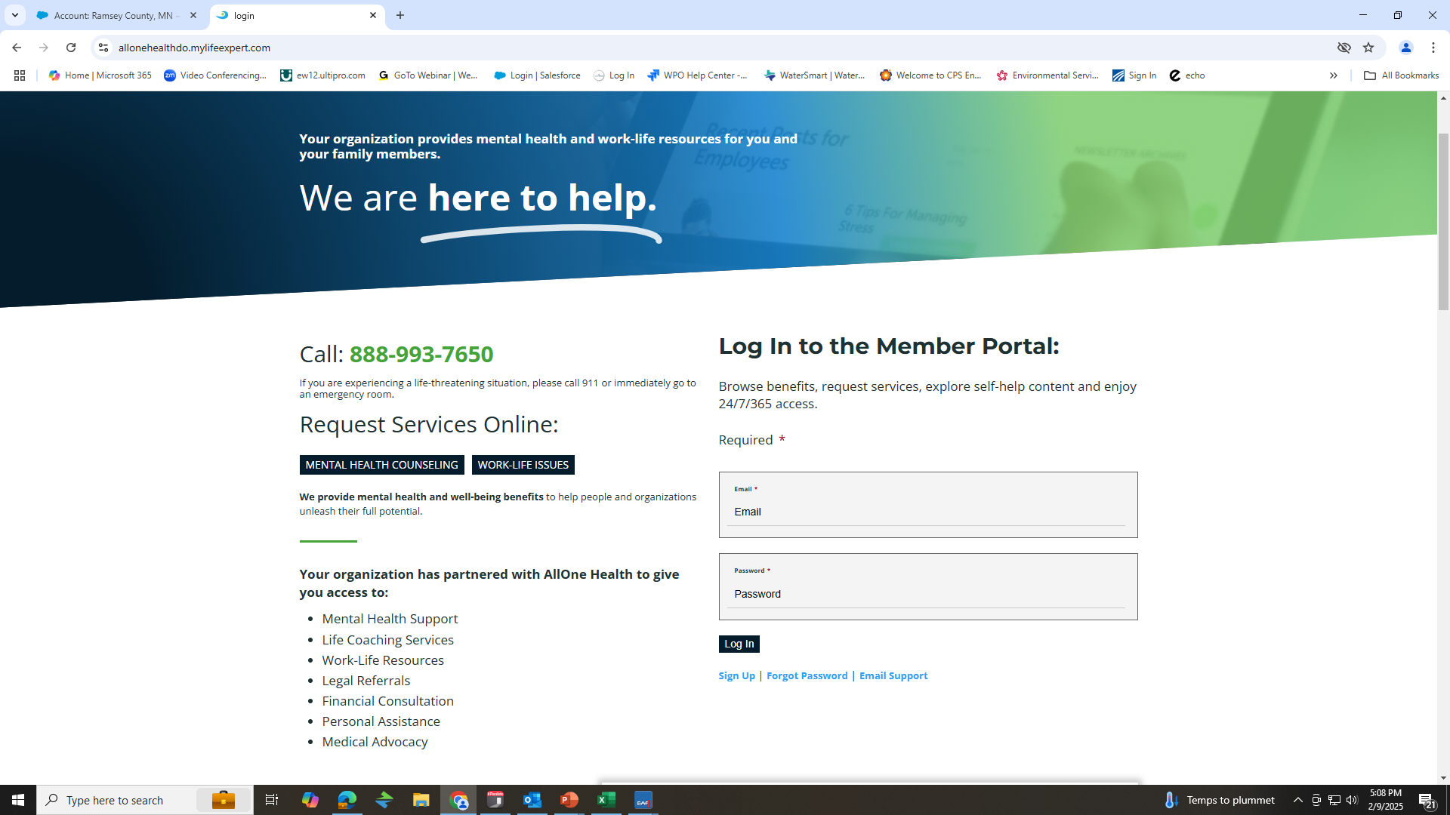
Notes:
Walk the audience through the logging in process
-if they have not created a member account, they will need to click “sign up” and use the company code, which is ramsey (one word and lower case)

Slide 20
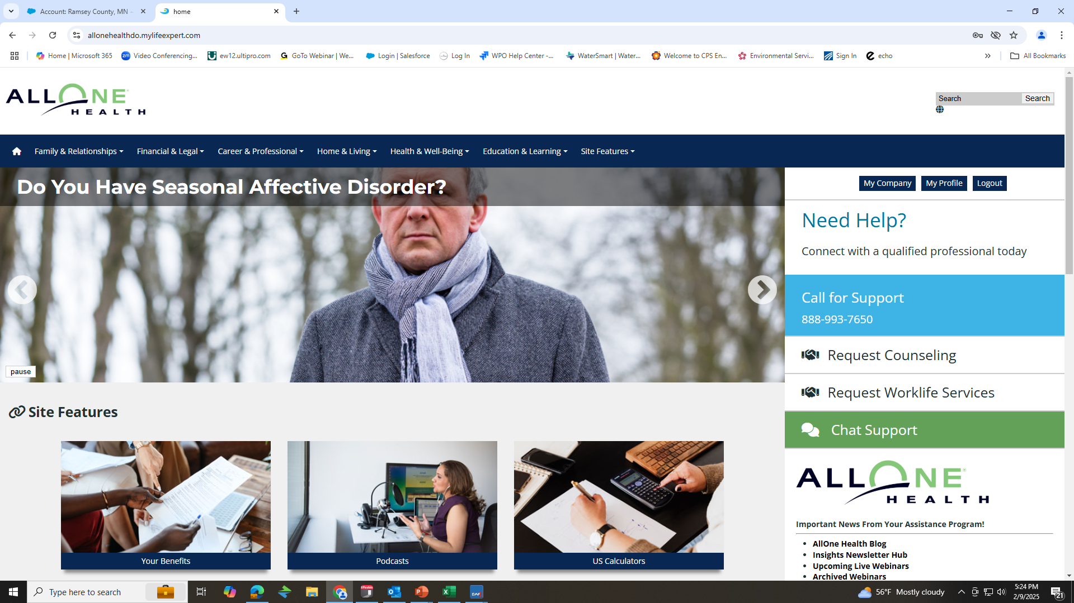
Notes:
Once on the homepage, show the audience where the can “request counseling” and “worklife services” and utilize “chat support”
Inform them that under “My Profile, they have an opportunity to view any completed Soft Skills assessments as well as keep a journal.

Slide 21
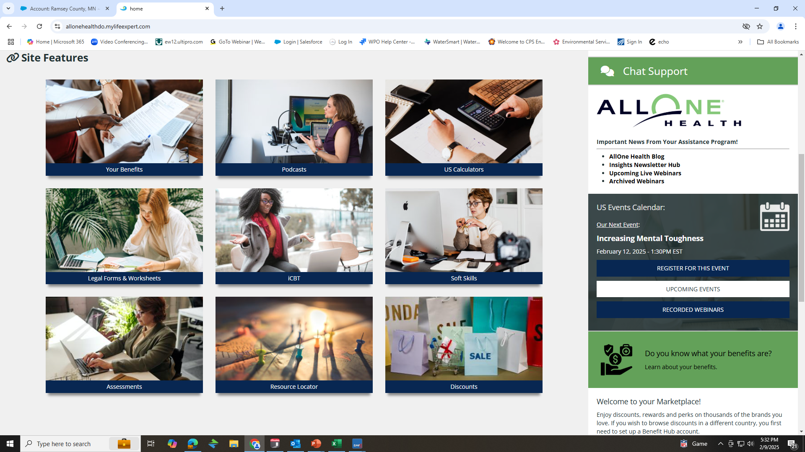
Notes:
Point out that Will Preparation forms can be found under the “Legal Forms and Worksheets”
iCBT is a self paced program that can assist with presenting issues such as “Anger Management, Grief, Communication and Stress and Anxiety…just to name a few examples

Slide 22

How to Access Your Employee Assistance Program:
Helpline: 1-888-993-7650
Email: eap-do@allonehealth.com
Website: allonehealth.com/deeroaks
Company Code: RCCD
Senior Account Manager: Kristina.Herrera@allonehealth.com
Notes:
Feel free to take a photo of this screen for your records.

