Slide 1
Teladoc Health for
Riverside Community College District
March 1, 2026
Notes:
Telehealth service for Blue Shield of California members from Banc of California

Slide 2
Member access
Convenient and secure access
blueshieldca.com/teladochealth
After authenticating at this link, member will Single Sign On (SSO) to Teladoc Health’s site
teladochealth.com/bsc is also available
Blue Shield mobile app
Click on Teladoc Health icon and automatically SSO to Teladoc Health
The Teladoc Health’s mobile app may also be used
(800) 835-2362
Members must first register their account and complete a medical history before their first visit
Members may request a visit in one mode but elect to conduct the visit in another (e.g., request a video visit but can choose to have a phone/audio-only visit)
Notes:
As we go through the slides, you will find that you will have to register on Teladoc and complete a medical history. I recommend you do that when you’re not ill and have the immediate need

Slide 3
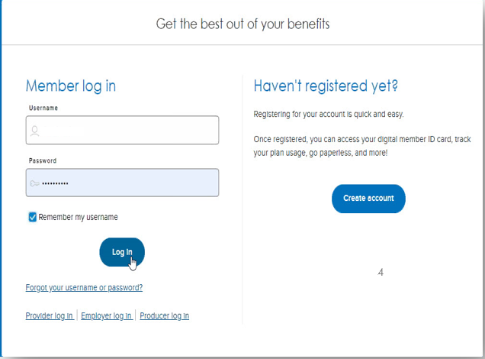
BSC Login Page before member goes to Teladoc Health
Website
App
Note: There is no return to login for the App since the App requires BSC login as first step

Slide 4
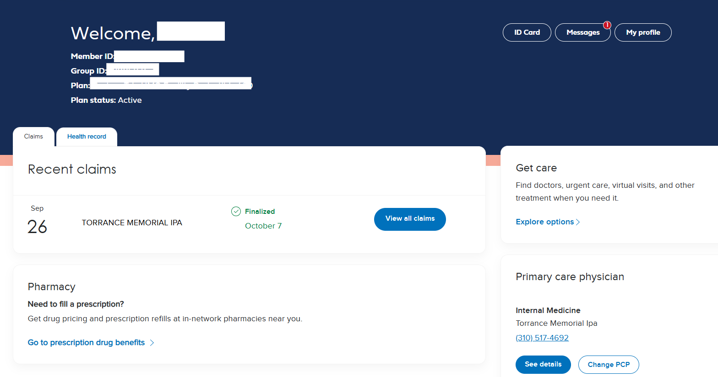
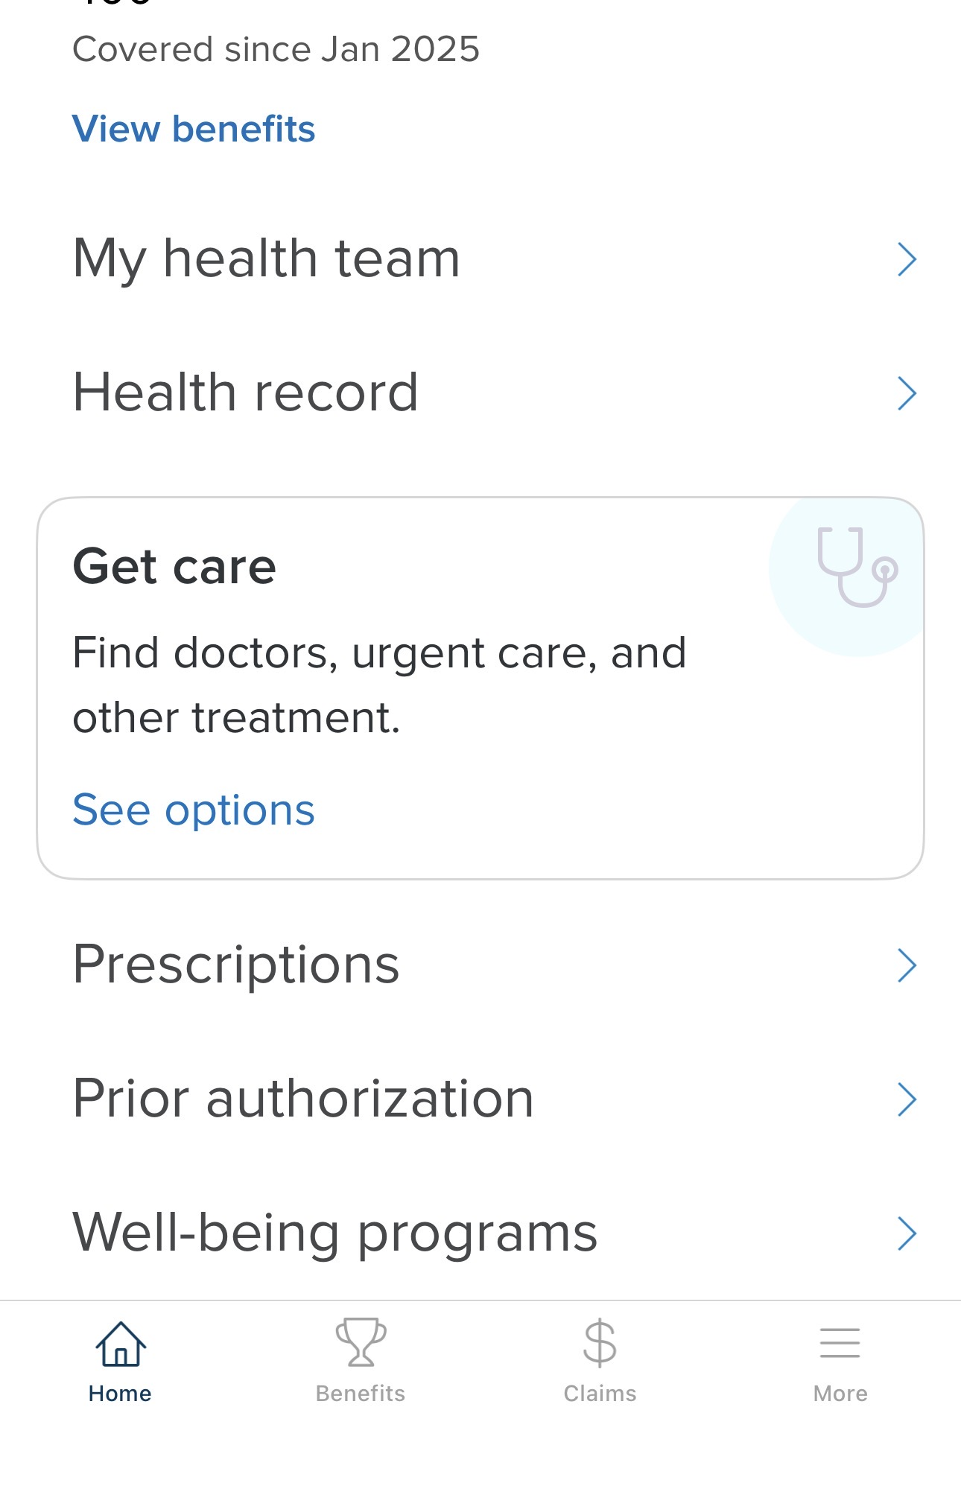
Single Sign On Process
Website
App

Slide 5
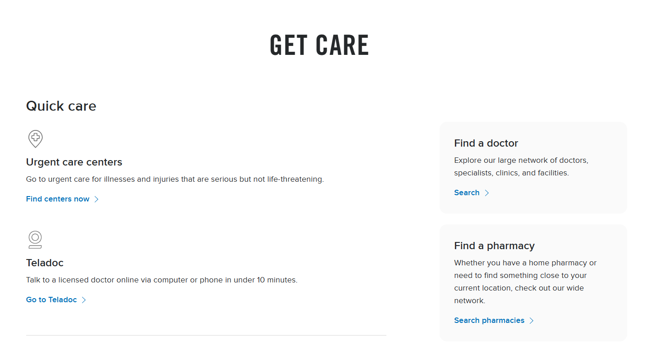
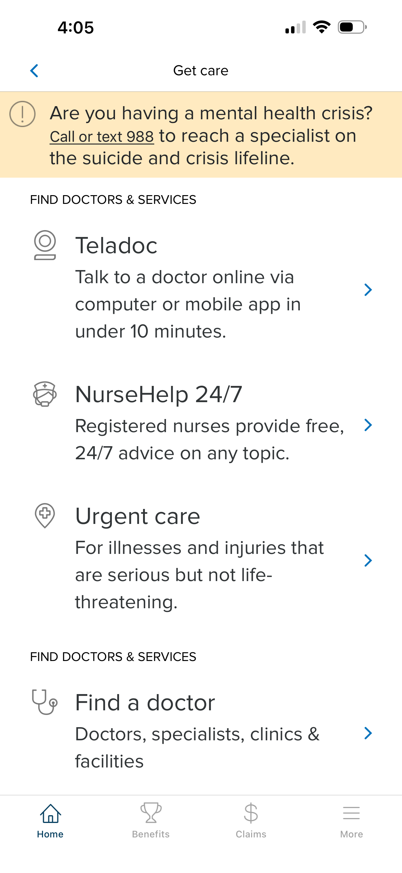
Get Care page
Website
App

Slide 6
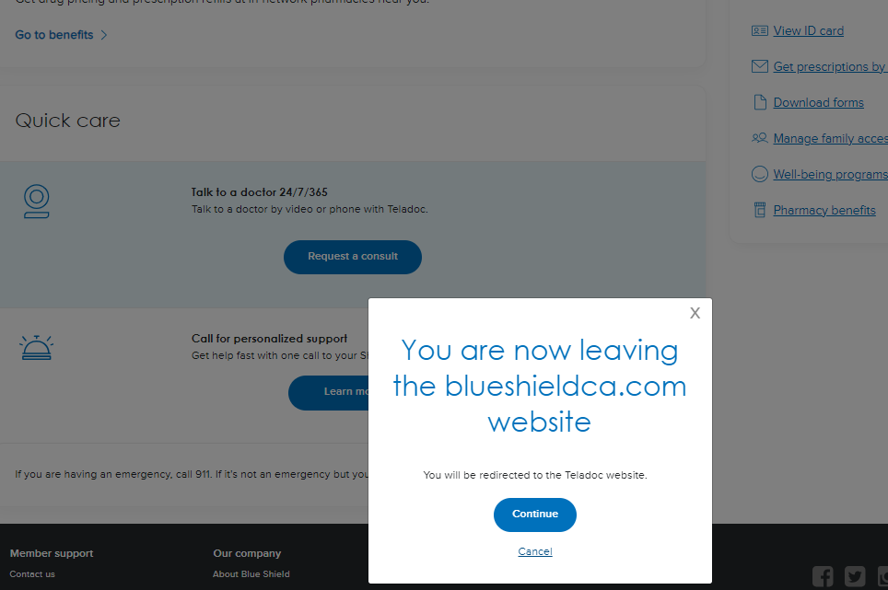
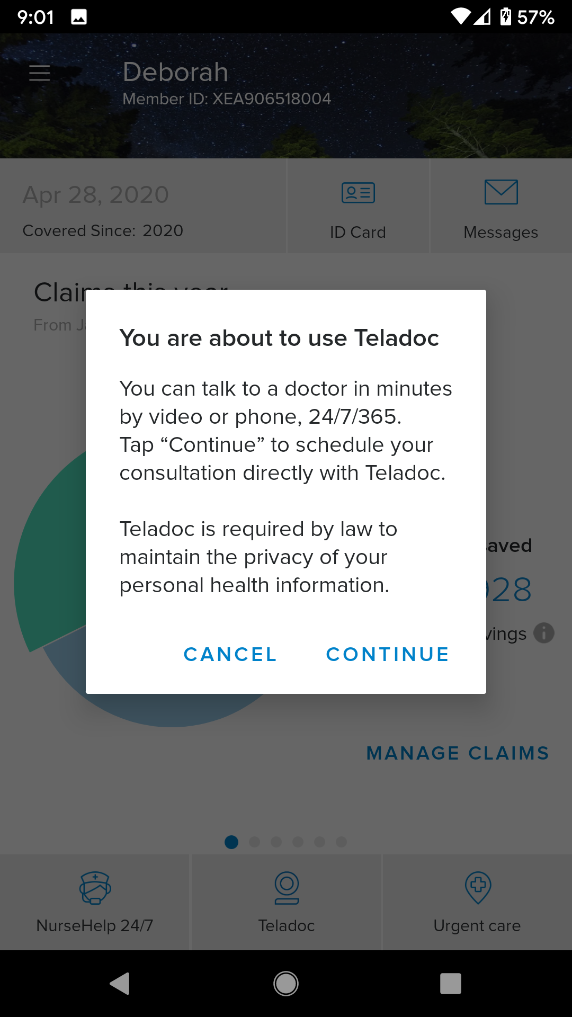
Message - Member Leaving BSC
Website
App

Slide 7
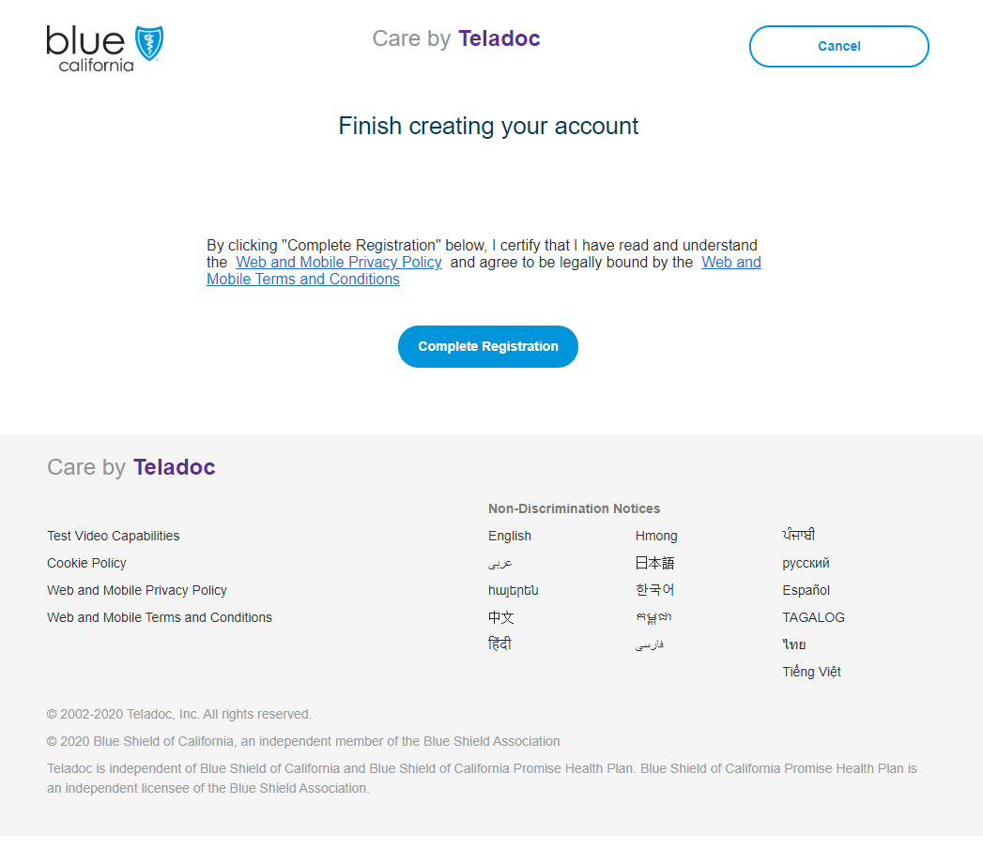
Teladoc site: first-time account creation
Website
App
Finish creating your account
By clicking “Complete Registration” below, I certify that I have read and understand the Web and Mobile Privacy Policy and agree to be legally bound by the Web and Mobile Terms and Conditions

Slide 8
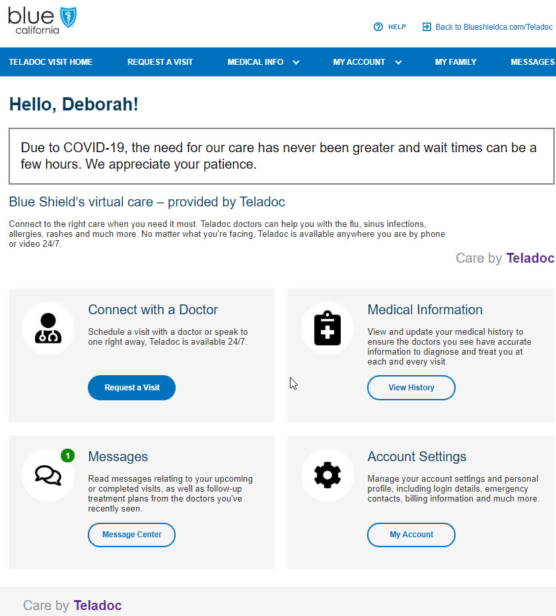
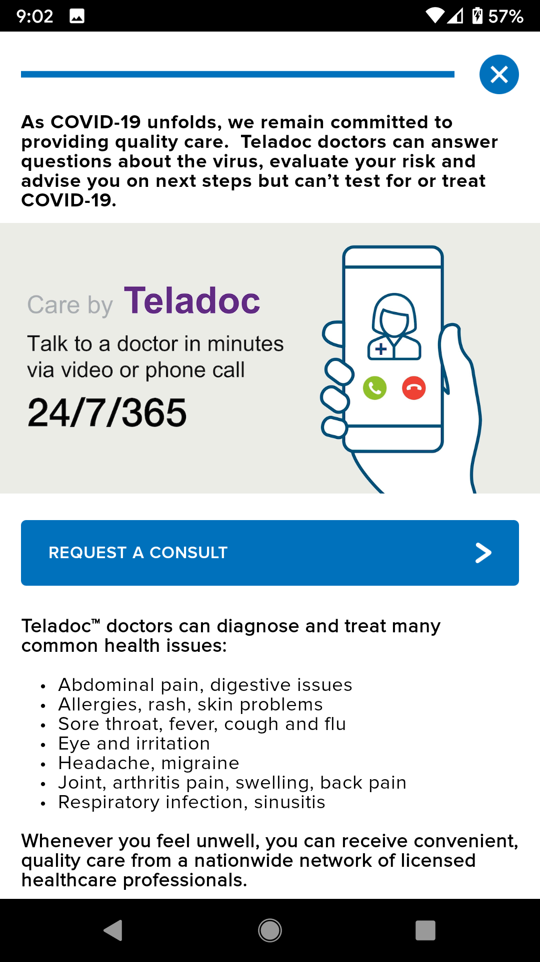
Member requests a consult
Website
App

Slide 9
General Medical virtual visits
General Medicine
Time availability | 24/7/365
On-demand appointments availability | Yes: within 60 minutes or less from request time; appointment can also be schedule.
Appointment scheduling process | Portal, app or Teladoc phone number
Visit mode | Video (mobile app or online), phone (audio only)
Available in all 50 states | Yes
Age availability | All
Can see same provider after initial visit? | No

