Slide 1
High School Articulated Credit
Office of Educational Services

Slide 2
What is High School Articulation Credit?
High school articulation is when a high school teacher and community college professors collaborate to align a college level course with a high school CTE class and determine they are equal.
Students who complete Career Technical Education (CTE), Regional Occupational Program (ROP), or Adult Education classes may be able to receive college credit for their courses.
An active articulation agreement must be in place between the student’s high school district and an RCCD college at the time the student was enrolled in the high school class.
Applying for articulation credit is optional, not mandatory. Once you apply for articulated credit it cannot be removed.

Slide 3

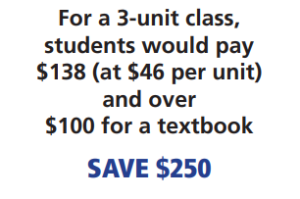
Benefits of High School Articulation Credit
Reduces the need to repeat coursework in college
Opportunities to receive early college credit through high schoolarticulation
Students may earn a maximum of 16 units
Articulated credit is FREE!

Slide 4
Where does high school articulated credit transfer to?
High School Articulated credit can be used towards a CTE Certificate or to meet general education requirements and/or units needed for an Associate Degree, or transfer to a four-year college or university.
As each institution is different and may have different requirements, you should want to check with the college you are attending to find out how you can use your articulation credit.
*Please note it is up to the receiving institution to accept or deny high school articulated credit

Slide 5
What if your student does not pass the class with a B or better?
If your student does not pass your high school course with the minimum grade required, no college record will be generated.
The course will NOT be listed on a college transcript. It will, however, still show up on your high school transcript with the grade you earned.
* Final grade is not comprehensive, it is based on the second semester and final exam outcomes

Slide 6
What is the students responsibility?
Student participation in the articulation process is essential to students receiving their credit.
To fulfill the minimum requirements students must earn B or better in the class and the final exam.
Please note for two semester articulated courses:
Students must earn a C or better in the first semester to remain eligible for articulated credit
Students must earn a B or better for the second semester and the final exam for the credit to be applied
* Final grade is not comprehensive, it is based on the second semester and final exam outcomes

Slide 7
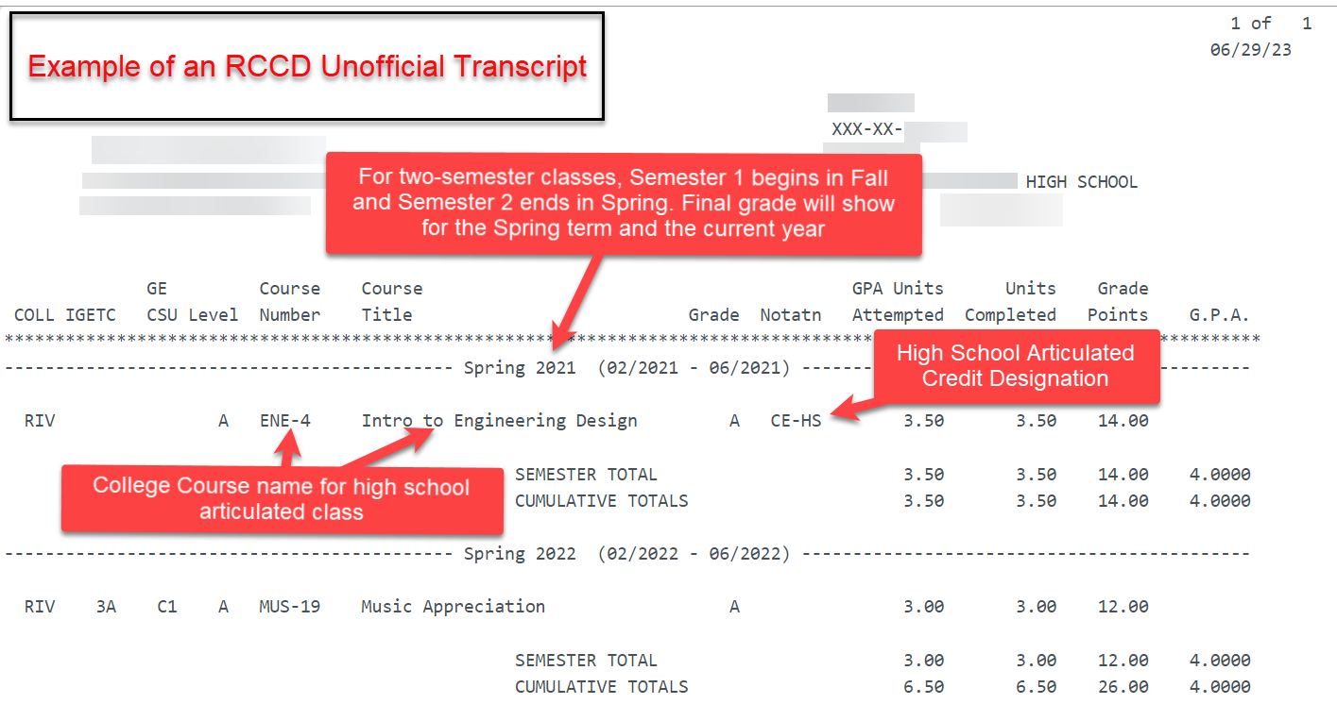
How does articulated credit show on students transcript?
High School Articulated credit will show as CE-HS and will list the college course name, not the high school class name.

Slide 8

Help your students with early start!
For further questions on setting up a new articulation agreement please contact
Adriana.Martinez@rccd.edu

